Slide 1
Developing an Application using C#.NET

Slide 2
Contents
what is .Net
.Net vs Java
what is mvc application
routing in mvc
Debugging
what is model, view, controller in dot net
structure of mvc code
ajax calls using jQuery in view
entityframework approach
unit testing
startup.cs code

Slide 3



Dotnet Application Team
Raviteja Pagidoju
Github
https://github.com/RaviTeja444
LinkedIn
https://www.linkedin.com/in/ravi-teja-pagidoju-b90a70184/
Shiva Rama Krishna Vodnala
Github
https://github.com/srkvodnala
LinkedIn
https://www.linkedin.com/in/shiva-rama-krishna-vodnala-1a5279157/
Swaroop Reddy Gottigundala
Github
https://github.com/SwaroopReddyGottigundala
LinkedIn

Slide 4
What is .NET?
.NET is an open source developer platform, created by Microsoft, for building many different types of applications.
You can write your .NET apps in C#, F#, or Visual Basic.
Platforms:
.Net Core
.Net Framework
Xamarian/Mono

Slide 5
.NET Core vs .NET Framework
Microsoft maintains both runtimes for building applications with .NET, and they share many of the same APIs. This shared API is what is called the .NETStandard.
Developers use the .NET framework to create Windows desktop applications and server based applications. This includes ASP.NET web applications.
.NET Core is used to create server applications that run on Windows, Linux and Mac.

Slide 6
.Net vs Java
Java is a programming language and can work on any operating system.
Java also provides Java Virtual Machine (JVM) which allows code should run on any device and any operating system.
.NET is actually a framework in the strictest meaning of this word.
ASP.NET is used by .NET to create different applications.
Java is a programming language, while .NET is a framework that can use several languages.

Slide 7
What is C#
.C# is an object-oriented programming language developed by Microsoft. It combines the computing power of C++ with ease of Visual Basic and Java.
While C# is based on C++ it also contains features similar to Java.
SHIVA RAMA KRISHNA

Slide 8
ASP.NET MVC
ASP.NET supports three major development models: Web Pages, Web Forms and MVC (Model View Controller).
ASP.NET MVC framework is a lightweight, highly testable presentation framework that is integrated with the existing ASP.NET features, such as master pages, authentication, etc.
Within .NET, this framework is defined in the System.Web.Mvc assembly. The latest version of the MVC Framework is 5.0. We use Visual Studio to create ASP.NET MVC applications which can be added as a template in Visual Studio.

Slide 9
Model-View-Controller (MVC)
The Model-View-Controller (MVC) is an architectural pattern that separates an application into three main logical components: the model, the view, and the controller.
Each of these components are built to handle specific development aspects of an application.
MVC is one of the most frequently used industry-standard web development framework to create scalable and extensible projects.

Slide 10
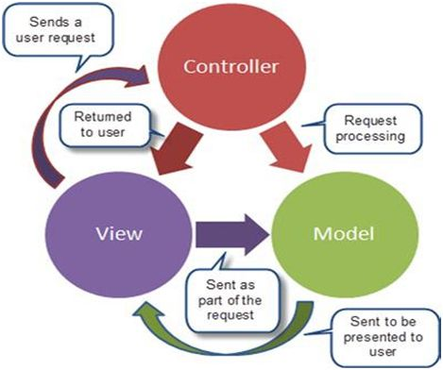
Structure of MVC Architecture

Slide 11
Model
Model is a part of the application data domain. Model consists of all the classes that handle data and business logic.
The Model is often a conceptual separation instead of the physical one.
Model retrieve and store state in database.

Slide 12
View
View is an aspx page without having code behind file.
View display the application user interface.
UI is created from model data.
Once the data processing is complete the controller classes are a response to the user by sending the result to a view.

Slide 13
Controller
It handles user interaction.
Controller is the heart of the entire MVC Architecture.
Controller is connecting Model and View.
Controller communicate Model and view.
Controller handles user request and response.

Slide 14
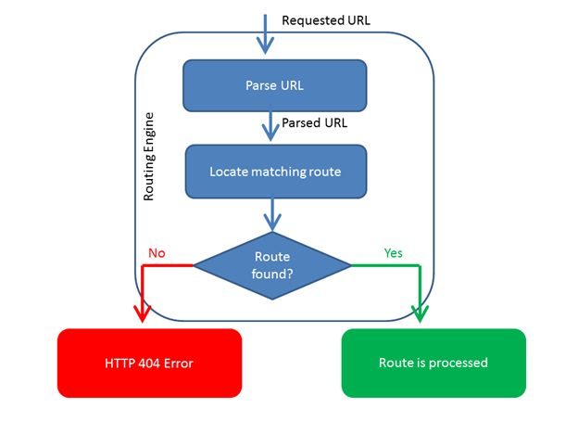
MVC Routing

Slide 15
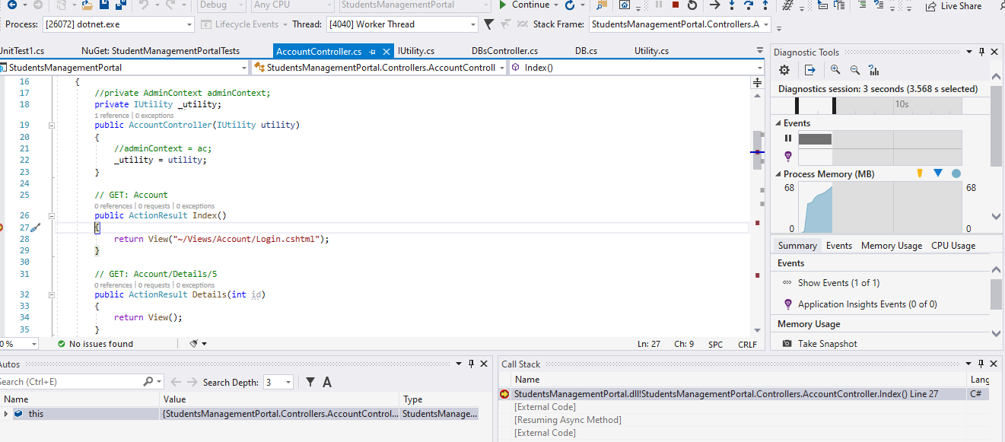
Debugging

Slide 16
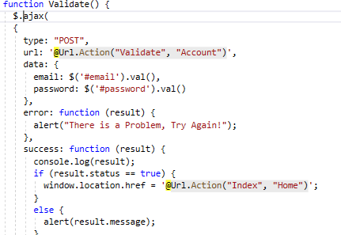
jQuery AJAX
AJAX calls are one method to load personalized content separately from the rest of the HTML document.

Slide 17
Entity Framework
Entity Framework Core is a modern object-database mapper for .NET. It supports LINQ queries, change tracking, updates, and schema migrations. EF Core works with SQL Server, Azure SQL Database, SQLite, Azure Cosmos.
We use frequently 2 Approaches to achieve ef
DB First approach
Code first approach
RAVI TEJA PAGIDOJU

Slide 18
Scaffolding
ASP.NET Scaffolding is a code generation framework for ASP.NET Web applications. From Visual Studio 2013 ,includes pre-installed code generators for MVC and Web API projects. You add scaffolding to your project when you want to quickly add code that interacts with data models. Using scaffolding can reduce the amount of time to develop standard data operations in your project.
In our project we have used scaffolding to generate controllers from our models.
RAVI TEJA PAGIDOJU

Slide 19
Unit Testing in ASP.NET MVC
In computer programming, unit testing is a software testing method by which individual units of source code are tested to determine whether they are fit for use. In other words, it is a software development process in which the smallest testable parts of an application, called units, are individually and independently scrutinized for proper operation.
Microsoft provides wide variety of unit testing frameworks
Microsoft fakes using stubs
Nunit testing
Moq is special third party library which helps us to manipulate the methods at Run time.
RAVI TEJA PAGIDOJU

Slide 20
startup.cs file
ASP.NET Core application must include Startup class. It is like Global.asax in the traditional .NET application. As the name suggests, it is executed first when the application starts
Configuration
Services collection
RAVI TEJA PAGIDOJU

Slide 21
Hosting
Visual studio provides a platform where we can directly deploy our application to cloud service providers like azure.we can also create a appservice directly from visual studio.
We can also publish our website to our local iis root folder.
Also in case if we want to deploy in a root machine,it also provides all the publishable files to a folder so that we can deploy it directly.
RAVI TEJA PAGIDOJU

Slide 22
Reference
https://dotnet.microsoft.com/apps/aspnet
https://dotnet.microsoft.com/
https://www.tutorialsteacher.com/mvc/mvc-architecture
https://www.c-sharpcorner.com/UploadFile/3d39b4/routing-in-mvc/

Slide 23
DEMO OF THE APPLICATION

Slide 24
THANK YOU

